Slide 1
Fuzzy Logic In AI
Prof. Dr. A K M Akhtar Hossain
Dept. of CSE, RU

Slide 2
What is Fuzzy Logic?
Fuzzy logic is a form of many-valued logic in which the truth values of variables may be any real number between 0 and 1, considered to be "fuzzy".
In Boolean logic, the truth values of variables may only be 0 or 1, often called "crisp" values.
Fuzzy logic has been employed to handle the concept of partial truth, where the truth value may range between completely true and completely false.
Furthermore, when linguistic variables are used, these degrees may be managed by specific (membership) functions.
© Prof. Dr. A K M Akhtar Hossain Dept. of CSE, RU

Slide 3
Fuzzy logic
Fuzzy logic is a branch of fuzzy set theory, which deals with the representation and inference from knowledge. Fuzzy logic, unlike other logical systems, deals with imprecise or uncertain knowledge.
In this narrow, and perhaps correct sense, fuzzy logic is just one of the branches of fuzzy set theory.
© Prof. Dr. A K M Akhtar Hossain Dept. of CSE, RU

Slide 4
Fuzzy Applications
  Topology;
  Linguistics;
  Automata theory;
  Game theory;
  Pattern recognition;
  Medicine;
  Law;
  Decision support;
  Information retrieval; etc.
© Prof. Dr. A K M Akhtar Hossain Dept. of CSE, RU

Slide 5
Fuzzy Logic History
The term fuzzy logic was introduced with the 1965 proposal of fuzzy set theory by Lotfi A. Zadeh.
© Prof. Dr. A K M Akhtar Hossain Dept. of CSE, RU

Slide 6
Example:
Words like young, tall, good, or high are fuzzy.
There is no single quantitative value which defines the term young.
For some people, age 25 is young, and for others, age 35 is young.
The concept young has no clean boundary.
Age 1 is definitely young and age 100 is definitely not young;
Age 35 has some possibility of being young and usually depends.
on the context in which it is being considered.
© Prof. Dr. A K M Akhtar Hossain Dept. of CSE, RU

Slide 7
Fuzzy set theory
Fuzzy set theory is an extension of classical set theory where elements have varying degrees of membership.
A logic based on the two truth values, True and False, is sometimes inadequate when describing human reasoning.
Fuzzy logic uses the whole interval between 0 (false) and 1 (true) to describe human reasoning.
© Prof. Dr. A K M Akhtar Hossain Dept. of CSE, RU

Slide 8
A Fuzzy Set
A Fuzzy Set is any set that allows its members to have different degree of membership, called membership function, in the interval
[0 , 1].
The degree of membership or truth is not same as probability;
fuzzy truth is not likelihood of some event or condition.
fuzzy truth represents membership in vaguely defined sets;
© Prof. Dr. A K M Akhtar Hossain Dept. of CSE, RU

Slide 9
Fuzzy logic
Fuzzy logic is derived from fuzzy set theory dealing with reasoning that is approximate rather than precisely deduced from classical predicate logic.
Fuzzy logic is capable of handling inherently imprecise concepts.
Fuzzy logic allows in linguistic form the set membership values to imprecise concepts like "slightly", "quite" and "very".
Fuzzy set theory defines Fuzzy Operators on Fuzzy Sets.
© Prof. Dr. A K M Akhtar Hossain Dept. of CSE, RU

Slide 10
Crisp and Non-Crisp Set
As said before, in classical set theory, the characteristic function μA(x) of Eq.(2) has only values 0 ('false') and 1 ('true'').
Such sets are crisp sets.
© Prof. Dr. A K M Akhtar Hossain Dept. of CSE, RU

Slide 11
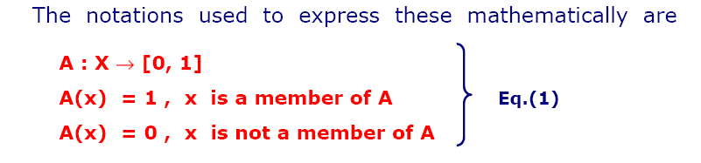
Crisp and Non-Crisp Set
© Prof. Dr. A K M Akhtar Hossain Dept. of CSE, RU

Slide 12
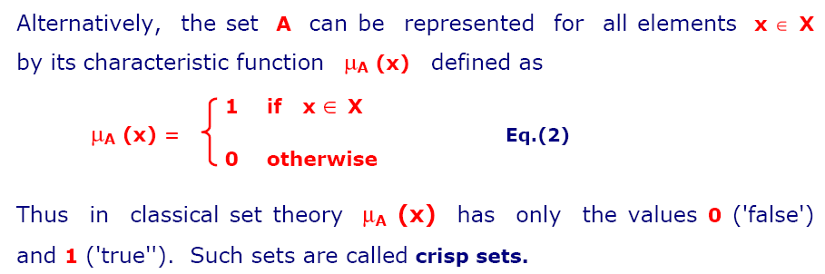
Crisp and Non-Crisp Set
© Prof. Dr. A K M Akhtar Hossain Dept. of CSE, RU

Slide 13
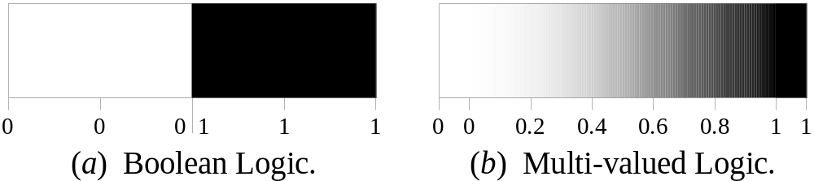
More Definitions
Fuzzy logic is a set of mathematical principles for knowledge representation based on degrees of membership.
Unlike two-valued Boolean logic, fuzzy logic is multi-valued. It deals with degrees of membership and degrees of truth.
Fuzzy logic uses the continuum of logical values between 0 (completely false) and 1 (completely true). Instead of just black and white, it employs the spectrum of colours, accepting that things can be partly true and partly false at the same time.
26th September 2006
Bogdan L. Vrusias © 2006

Slide 14
Fuzzy Sets
The concept of a set is fundamental to mathematics.
The classical example in fuzzy sets is tall men. The elements of the fuzzy set “tall men” are all men, but their degrees of membership depend on their height. (see table on next page)
26th September 2006
Bogdan L. Vrusias © 2006

Slide 15
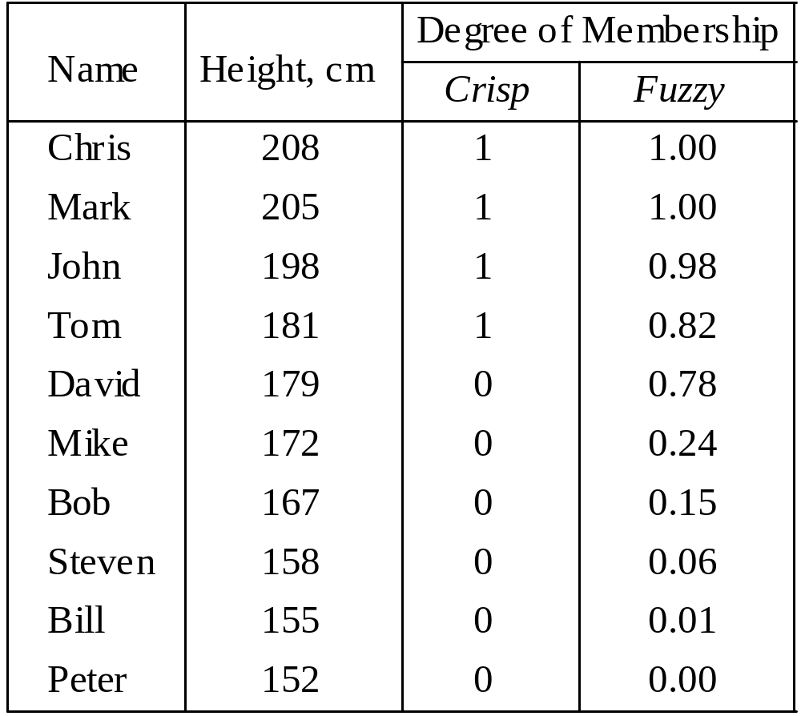
Fuzzy Sets
26th September 2006
Bogdan L. Vrusias © 2006

Slide 16
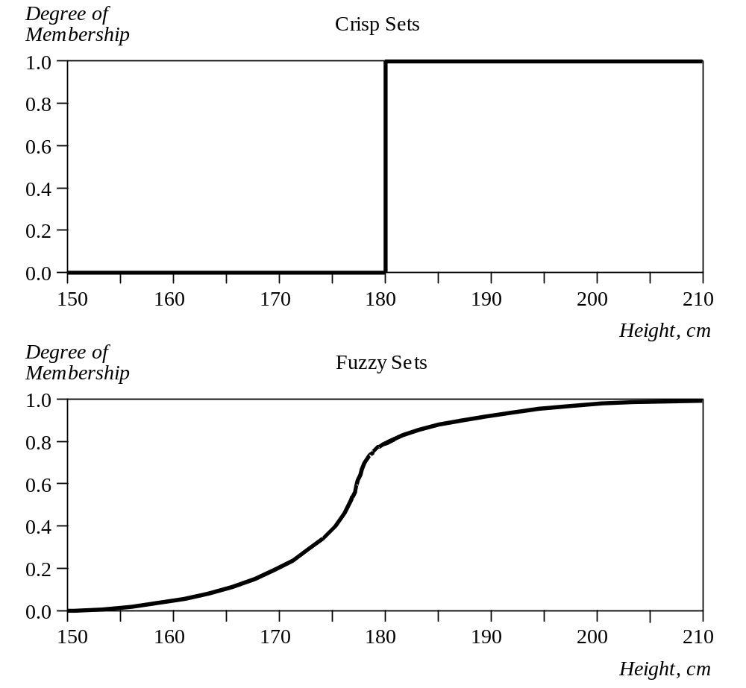
Crisp Vs Fuzzy Sets
The x-axis represents the universe of discourse – the range of all possible values applicable to a chosen variable. In our case, the variable is the man height. According to this representation, the universe of men’s heights consists of all tall men.
The y-axis represents the membership value of the fuzzy set. In our case, the fuzzy set of “tall men” maps height values into corresponding membership values.
26th September 2006
Bogdan L. Vrusias © 2006

Slide 17
Example: Fuzzy Sets
Hard science with IF-THEN rules
For example, the logic for a simple temperature regulator that uses a fan might look like this:
© Prof. Dr. A K M Akhtar Hossain Dept. of CSE, RU

Slide 18
IF temperature IS very cold THEN stop fan
IF temperature IS cold THEN fan speed is zero
IF temperature IS warm THEN fan speed is moderate
IF temperature IS hot THEN fan speed is high
© Prof. Dr. A K M Akhtar Hossain Dept. of CSE, RU

